Slide 1

8 Slide Guide to Co-Optima
John Farrell, John Holladay, Art Pontau, Robert Wagner
March 28, 2016

Slide 2

Goal: better fuels and better vehicles sooner
Fuel and Engine Co-Optimization
What fuel properties maximize engine performance?
How do engine operating strategies affect efficiency?
What fuel and engine combinations are sustainable, affordable, and scalable?
Notes:
Engine Performance: is about vehicle performance (acceleration, power, etc note: there are other performance properties like cornering/handling that are not about engine performance). Performance is important for consumer acceptance
Engine Efficiency is critical to meet goals in greenhouse gas reduction and fuel economy
Some consumers demand performance over efficiency, others demand efficiency. To make inroads we will want to optimize around performance and efficiency.
Regardless, we need to be able to do all this in a manner that is sustainable (economically, environmentally, and socially), affordable to consumers, and scalable within our fuel infrastructure.

Slide 3
Co-Optimization Hypotheses
There are engine architectures that provide higher thermodynamic efficiencies than available from modern internal combustion engines; new fuels are required to maximize efficiency and operability across a wide speed/load range.
If we identify target values for the critical fuel properties that maximize efficiency and emissions performance for a given engine architecture, then fuels that have properties with those values (regardless of chemical composition) will provide comparable performance.
Governing Hypotheses
Governing Hypotheses
Central Fuel Hypothesis
Notes:
An engine architecture refers to the powerplant (spark-ignition Otto-cycle, compression-ignition, etc.)
An engine system refers to the powerplant and the remainder of the system that powers the vehicle

Slide 4
Getting new fuels and engines into the marketplace is a tremendous challenge and requires that we address market barriers and environmental performance metrics.
Organizing Principles
Notes:
There are a lot of these principles. They are highly lumped in this slide around market barriers and environment. They could include things like:
Identify bio-based blendstocks that have the potential to be provided sustainably, affordably, and at scale, characterized by their properties (physical, chemical, and blending properties), map performance of these properties against various engine architectures, and identify the key market opportunities and challenges for each blendstock;
Examine advanced engine architectures and identify what fuel properties lead to maximum efficiency in these engines;
Produce engine maps through experiment and modeling of key engine architectures across operating conditions at each drive cycle and in different platforms (e.g., hybridization, on board separation, etc.); and
Explore new models and paradigms for fueling vehicles (how new fuels and vehicles can be introduced into the market).

Slide 5
Thrust I – Spark Ignition (SI) Focuses on turbocharged, boosted, high compression ratio (CR) spark ignition engines and the fuels that allow these vehicles to operate optimally.
Thrust II – Advanced Compression Ignition (ACI)
Focuses on highly efficient strategies including things like: gasoline compression ignition, reactivity controlled compression ignition, on-board reformation, lean/dilute spark, and so forth.
Two Thrusts

Slide 6






Research Tools Developed
Co-Optima is developing unique suite of research tools
Fuels Database Ties fuel chemical functional groups to fuel properties
Engine Performance Merit Function Defines relative importance of fuel properties to efficiency
ASSERT and Market Transformation Metrics Provides bucketed pros and cons for each fuel and engine
Scenario Analysis Tool Allows user defined weighting of criteria to understand options within market scenarios
Fuel Property Data Base
(Tier 2 and Tier 3)
ASSERT
Metrics
Merit
Function
MT
Metrics
Scenario Analysis Tool
(user defined weighting)
promising low-GHG blendstocks for advanced engine architectures

Slide 7
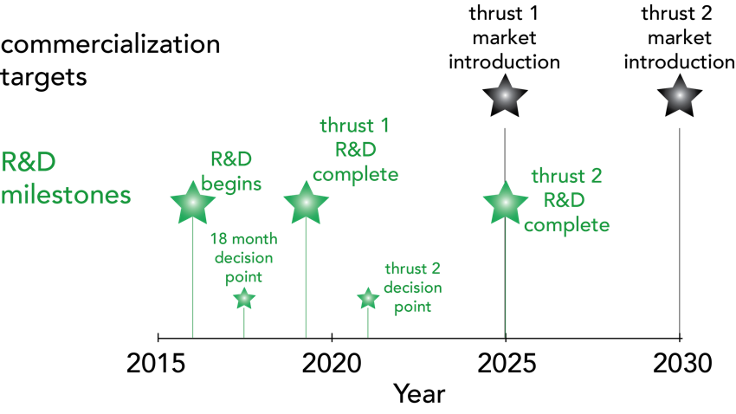
7
Timeline

Slide 8
Actionable data on vehicle engine systems and motor transportation fuels includes things like:
Robust engine performance data.
Identification of critical fuel properties needed for each engine type.
Identification of blendstocks and the pathways for their production.
Evaluation of the impurities that will arise in production of each blendstock.
Fuel blending behavior with base blends.
Engine testing that confirm performance (e.g., test boundaries of central fuel hypothesis).
Bucket analysis on sustainability, including: market transformation, cost, and greenhouse gas reduction.
Detailed analysis of a subset of candidates which can be directed to general trends.
Show how fuel-engines combinations preference may change under various scenarios
Co-Optima Charter
Provide stakeholders with unbiased, science-based, actionable data on vehicle engine architectures and motor transportation fuels.
In this we are allowing the market to choose its own options and/or informing policy makers.
We are not picking the winners nor developing engines.

Slide 9
Additional Slides

Slide 10
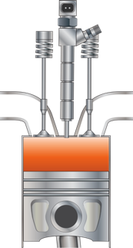
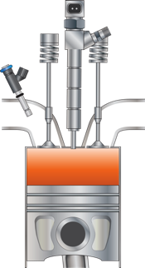
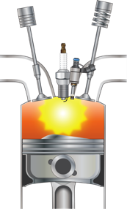
Each engine architecture will desire a different fuel mixture*
*e.g., require different fuel properties to operate across load

Slide 11
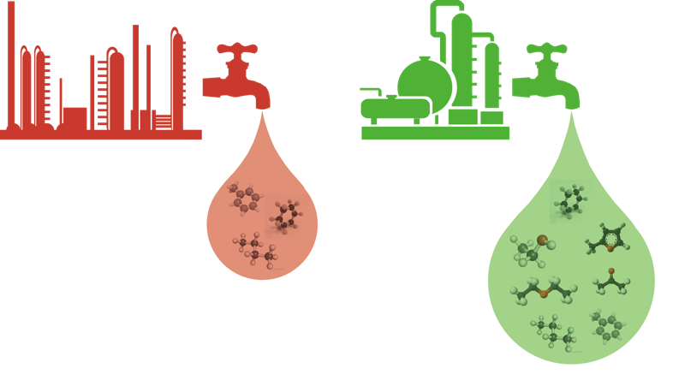
Biofuels provide unique fuel options and properties
11
petroleum-derived fuels
biomass-derived fuels
paraffins
olefins
aromatics
paraffins
olefins
aromatics
alcohols
fatty esters
ethers
ketones
furanics

Slide 12
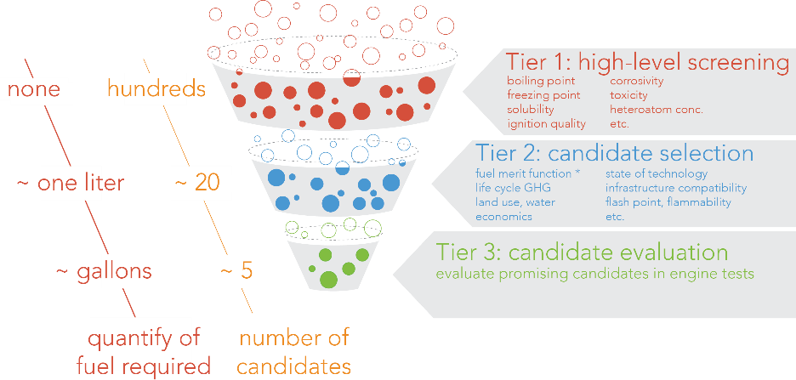





Fuel selection criteria (“decision tree”)

Slide 13
13
18 Month Decision Point
Determine the relative research balance of Thrust I and Thrust II for each team of Co-Optima.
Note: It is likely that the Thrust I – Thrust II research balance will differ for each team pursuant of short term and long term Co-Optima goals.
Fuel Property Data Base
(Tier 2 and Tier 3)
ASSERT
Metrics
Merit
Function
MT
Metrics
Scenario Analysis Tool
(user defined weighting)
promising low-GHG blendstocks of which they are comprised

Slide 14
FY16 Activities

Slide 15
Six integrated teams
Low
Greenhouse
Gas Fuels
Advanced
Engine
Development
Fuel
Properties
Identify promising bio-derived blendstocks, develop selection criteria for fuel molecules, and identify viable production pathways,
Quantify interactions between fuel properties and engine design and operating strategies – enabling optimal design of efficient, emission-compliant engines
Identify critical properties and allowable ranges, systematically catalogue properties, and predict fuel blending behavior
Fuels
LGGF
AED
Modeling and
Simulation
Toolkit
Analysis of
Sustainability,
Scale, Economics, Risk, and Trade
Market
Transformation
Extend the range, confidence and applicability of engine experiments by leveraging high-fidelity simulation capabilities
TK
ASSERT
Identify and mitigate challenges of moving new fuels and engines to markets and engage with full range of stakeholders
Analyze energy, economic, and environmental benefits at US economy-level and examine routes to feedstock production at scale through existing biomass markets
MT

Slide 16
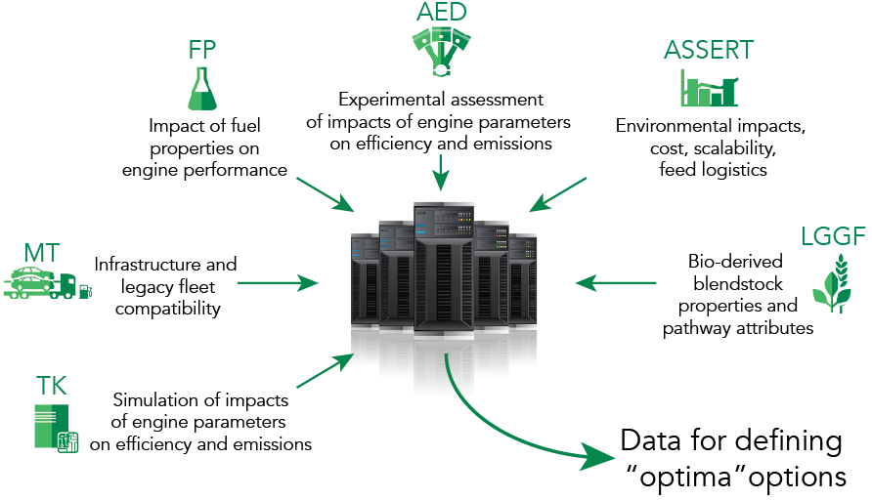
The 18 months decision point
16

Slide 17
What fuels can we make?

Slide 18
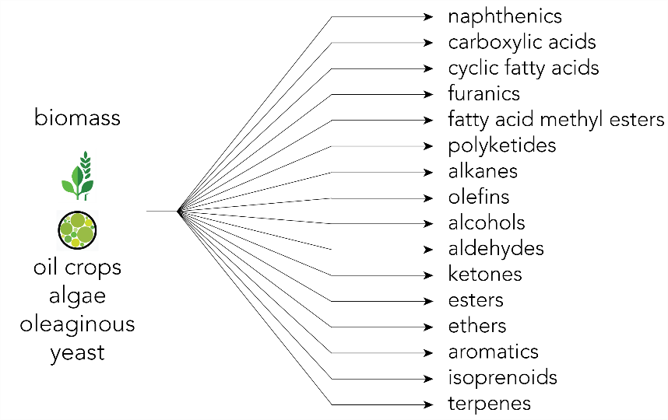


Slide 19
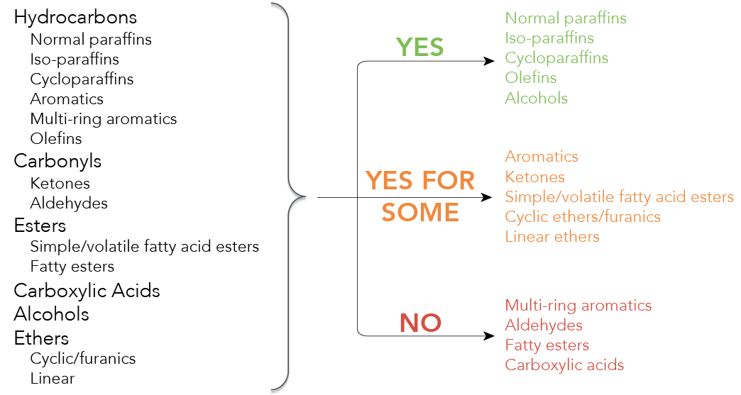
Decision tree results

Slide 20



Fuel property database and blending model
Database of critical fuel properties of petroleum & bio-derived blendstocks
Augment existing models to predict blending behavior of bio-blendstocks
Shared resource for team and public

Slide 21

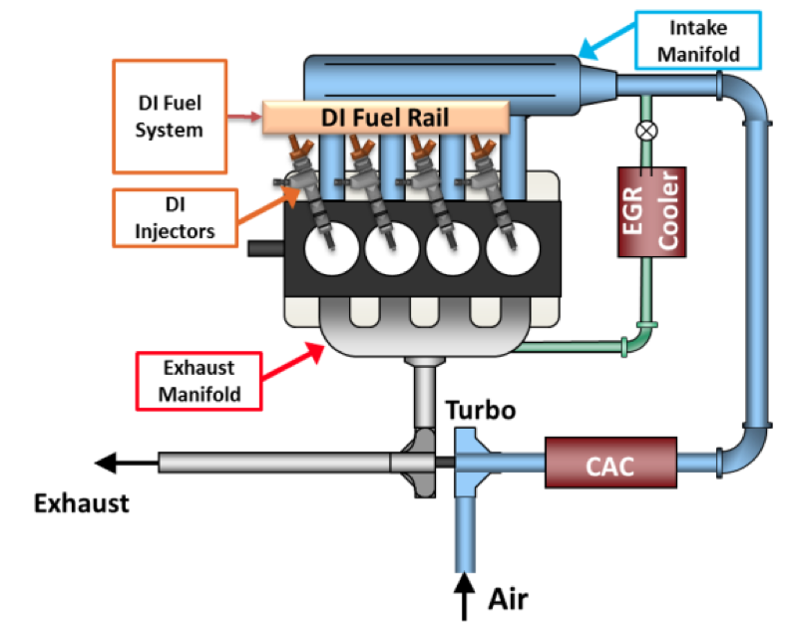
Fuel hypothesis development / evaluation
Develop of hypothesis via evaluation of readily available blendstocks
Testing of hypothesis with bio-blendstocks
Assessment of whether we have the right properties

Slide 22
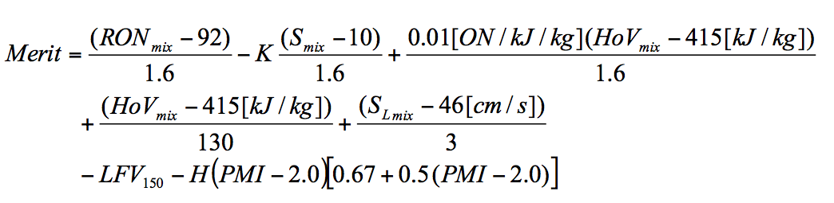

Engine performance merit function
Provides systematic ranking of blendstock candidates on engine efficiency when multiple fuel properties are varying simultaneously
Allows fuel economy gains to be estimated based on fuel properties
RON = research octane number
K = engine-dependent constant
S = sensitivity (RON-MON)
ON = effective octane number
HoV = heat of vaporization
S_{L} = flame speed
LFV = lower volume fraction
H = Heaviside function
PMI = particle mass index

Slide 23
M
First major milestone: 18 month decision point
Marks completion of Thrust 1 (advanced spark ignition) fuel discovery efforts (i.e., candidate identification)
Will conduct rigorous assessment of fuel/engine options and identify promising* low-GHG fuel/engine combinations
Will identify whether new low-GHG fuel candidates have been identified that require additional development work
Outcome will dictate balance between Thrust 1 vs Thrust 2 work after 18 months
* Sustainable, affordable, scalable

Slide 24
M
Status and next steps
Initiative started October 1 2016
FY16 budget: $27M; FY17 budget request: $30M
External advisory board formed (first meeting 2/24/16)
Active stakeholder engagement efforts underway

Slide 25
Thank You

